Slide 1
Weekly report: Team Project Development
Week number: 11
Date: 9/12/2025
Supervisor: Dr. Marina Blohm
Group members: Sohil Mansuri, Luis Urhahn, Ahmed Sallam, Ceren Cetin
Presenter: Sila Ceren Cetin

Slide 2
Task of the week
Battery Storage
Earthquake Evaluation
Cost of Transportation Analysis
Sila Ceren Cetin

Slide 3
Battery Storage – Placement & Key Restrictions
Location Strategy:
Place near the wind farm substation or collector station to minimize cable length, electrical losses, and connection costs.​ [4]
Site Selection Criteria:
Flat, stable ground outside flood zones, with direct road access for maintenance and emergency vehicles.​ [5]
Fire & Safety Codes – Setback Requirements:
5–10 m from public roads; minimum 10–15 m setback from buildings,
Fire-suppression systems, smoke detection, and emergency escape routes mandatory. ​[7]
Environmental Compliance:
Spill containment systems prevent battery electrolyte leakage into soil or groundwater; site includes fencing, warning signs, lightning protection, and local zoning compliance.​ [6]
Applicable Standards:
Follow NFPA 855 (fire safety) and UL 9540A (energy storage testing). Syria has no wind-specific BESS restrictions but requires compliance with general safety and planning regulations. [7]

Slide 4
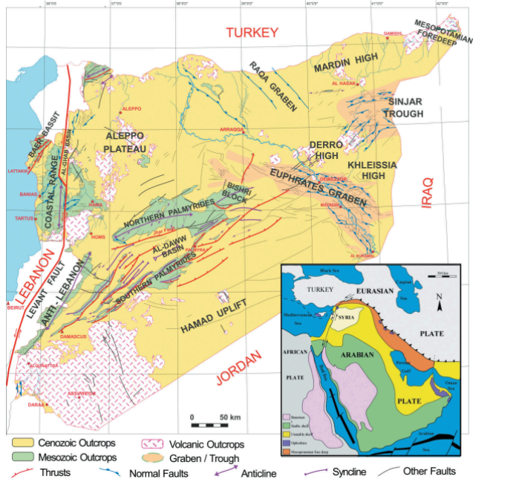
Main Fault Lines
● The Qattinah region is close to the Dead Sea Transform Fault
● Local fault branches from this system pass near Lake Qattinah (Lake Homs), increasing the seismic risk in the area.
● The interaction of these faults with the regional geology makes Qattinah seismically significant within Syria.
[2]
[1]
Sila Ceren Cetin

Slide 5
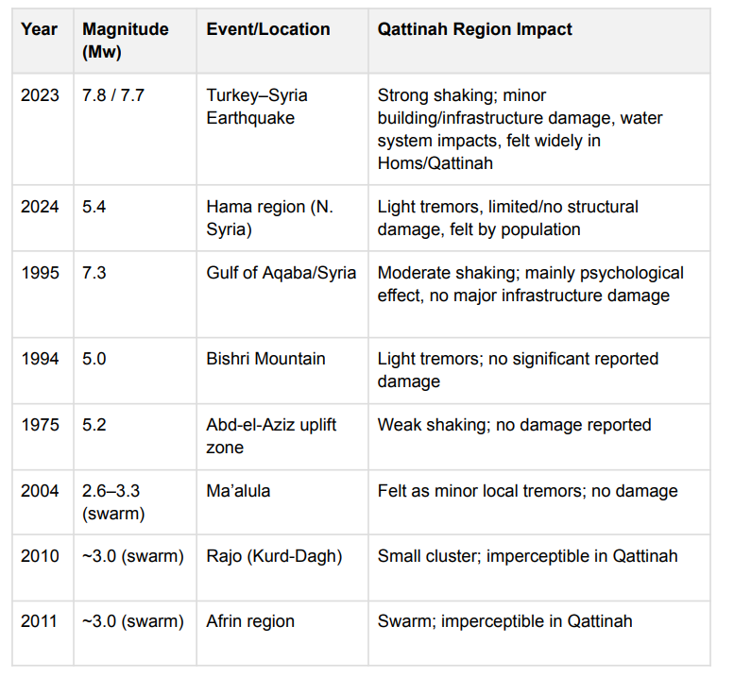
Last 50 years earthquakes
Sila Ceren Cetin

Slide 6
Consideration of Earthquake Risk
DNV-RP-0585 is an international engineering guideline for seismic design of wind power plants. It describes how to assess earthquake hazards and safely design wind turbines and foundations.
Use the local seismic hazard (considering fault lines and historical earthquakes).
Design for the 475-year return period event (Ultimate Limit State scenario).
Ensure the wind turbine and foundation can safely withstand earthquake forces, including soil-structure interaction.
Seismic Parameters for 475-Year Return Period (Ultimate Limit State):
Peak Ground Acceleration (PGA): Approximately 0.38–0.40g for western Syria (Homs, Hama, Latakia regions
Richter Scale History: Over the last 50 years, earthquakes of M≥7.0 have occurred (2023 Turkey-Syria M7.7/7.6), with approximately 60 earthquakes in the M 5.0–6.0 range recorded
[3]
Sila Ceren Cetin

Slide 7
Transportation Analysis
1. BLADES TRANSPORT – €290,000
Reference (2022): 3 blades × 90 m, Spain → Sweden = €150,000
Multipliers for Qattinah:
1.15× – Larger rotor (blades for 5 MW class)
1.25× – Longer international route (Europe → Middle East via Suez/Red Sea) + Syrian domestic logistics
1.25× – Loading at source, unloading at site, permits, escort services
Calculation: €150,000 × 1.15 × 1.25 × 1.25 = €290,000
2. NACELLE, HUB & DRIVETRAIN
Component weight: ~90 tonnes
Cost per tonne (from blade reference): €5,805/tonne
90 tonnes × €5,805/tonne = €522,450
3. TOWER
Component weight: ~225 tonnes
Cost per tonne: €1,900/tonne
225 tonnes × €1,900 = €427,500
Sila Ceren Cetin

Slide 8
Bibliography – Project Development
[1] https://www.researchgate.net/publication/277647278_Petroleum_Systems_of_Syria/figures?lo=
[2] Garfunkel, Z. (2014). "The Dead Sea Transform and its affect on the geology of the Levant region." Tectonophysics, 301(1-2), 5-27.
[3] https://www.scirp.org/journal/paperinformation?paperid=23230
[4] Battery Storage Manual, Sustainable Energy Authority of Ireland (SEAI), 2024.​
[5] Battery Storage Siting for Developers: A Guide for Enhancing Energy Management, Enverus, 2025.​
[6] What Land is Suitable for an Energy Storage Facility? Electrum, Sept. 2024.​
[7] 8 Battery Energy Storage System (BESS) Site Requirements, Kimley-Horn, May 2024.
Sila Ceren Cetin

